Slide 1
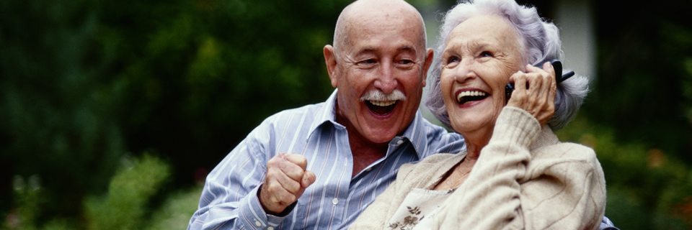
Geriatric Epidemiology
By: MH Emamian, MD, MPH, PhD

Slide 2
Facts on ageing and the life course

Slide 3
Facts on ageing and the life course
The world's population of people 60 years of age and older has doubled since 1980 and is forecast to reach 2 billion by 2050.
Between 2000 and 2050, the proportion of the world's population over 60 years will double from about 11% to 22%.

Slide 4
Facts on ageing and the life course
The number of people aged 80 and older will quadruple in the period 2000 to 2050
By 2050 the world will have almost 400 million people aged 80 years or older. Never before have the majority of middle-aged adults had living parents.

Slide 5
Facts on ageing and the life course
By 2050, 80% of older people will live in low- and middle-income countries
Chile, China and the Islamic Republic of Iran will have a greater proportion of older people than the United States of America. The number of older people in Africa will grow from 54 million to 213 million.

Slide 6
Facts on ageing and the life course
The main health burdens for older people are from noncommunicable diseases
Already, even in the poorest countries the biggest killers are heart disease, stroke and chronic lung disease, while the greatest causes of disability are visual impairment, dementia, hearing loss and osteoarthritis.

Slide 7
Facts on ageing and the life course
Older people in low- and middle-income countries carry a greater disease burden than those in the rich world
Older people in low- and middle-income countries have around three times the number of years lost to premature death from heart disease, stroke, and chronic lung disease. They also have much higher rates of visual impairment and hearing loss. Many of these problems can be easily and cheaply prevented.

Slide 8
Facts on ageing and the life course
The need for long-term care is rising
The number of older people who are no longer able to look after themselves in developing countries is forecast to quadruple by 2050. Many of the very old lose their ability to live independently because of limited mobility, frailty or other physical or mental health problems. Many require long-term care, including home-based nursing, community, residential and hospital-based care.

Slide 9
Facts on ageing and the life course
Effective, community-level primary health care for older people is crucial
Good care is important for promoting older people's health, preventing disease and managing chronic illnesses. Most training for health professionals does not include instruction about specific care for older people. However, health workers will increasingly spend more of their time caring for this section of the population. WHO maintains that all health providers should be trained on ageing issues.

Slide 10
Facts on ageing and the life course
Supportive, “age-friendly” environments allow older people to live fuller lives and maximize the contribution they make
Creating “age-friendly” physical and social environments can have a big impact on improving the active participation and independence of older people.

Slide 11
Facts on ageing and the life course
Healthy ageing starts with healthy behaviors in earlier stages of life
These include what we eat, how physically active we are and our levels of exposure to health risks such as those caused by smoking, harmful consumption of alcohol, or exposure to toxic substances. But it is never too late to start: for example, the risk of premature death decreases by 50% if someone gives up smoking between 60 and 75 years of age.

Slide 12
Facts on ageing and the life course
We need to reinvent our assumptions of old age
Society needs to break stereotypes and develop new models of ageing for the 21st century. Everyone benefits from communities, workplaces and societies that encourage active and visible participation of older people.

Slide 13
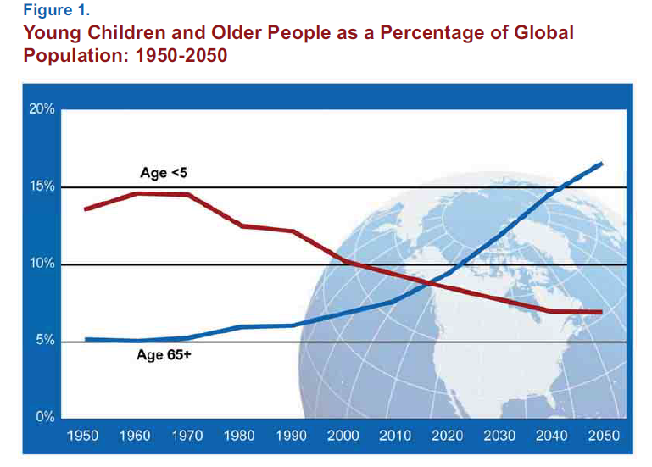
the number of people aged 65 or older will outnumber children under age 5

Slide 14
the proportion aged 80 or older is rising quickly, and more people are living past 100.
Prevalence of dementia rises sharply with age. An estimated 25-30 percent of people aged 85 or older have dementia.
The vast majority of older people—and the most rapidly aging populations—are in less developed countries.

Slide 15
Between 2010 and 2050, the number of older people in less developed countries is projected to increase more than 250 percent, compared with a 71 percent increase in developed countries.

Slide 16
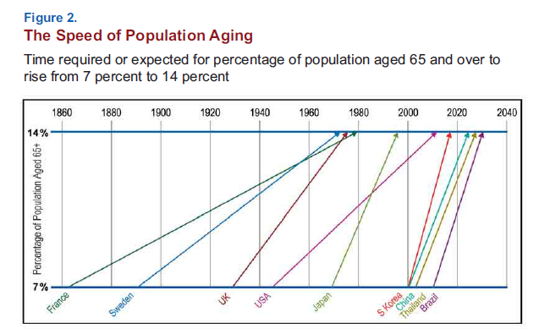

Slide 17
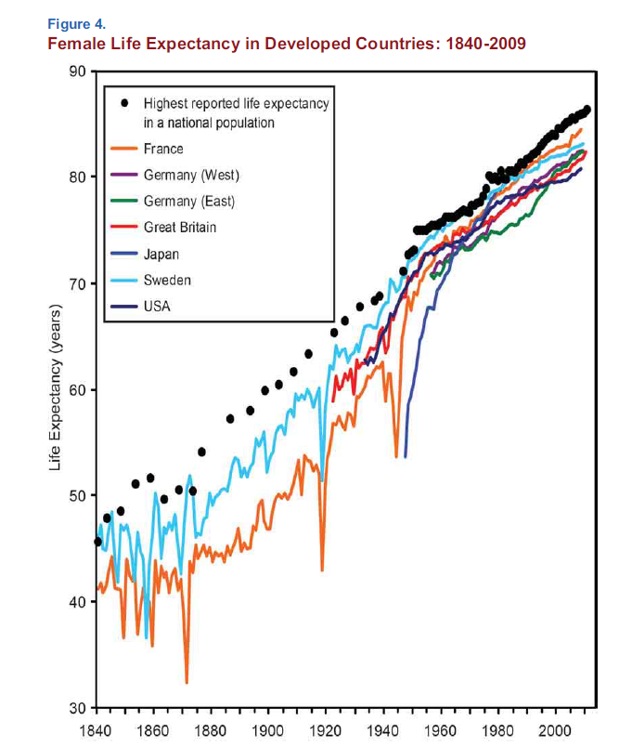

Slide 18
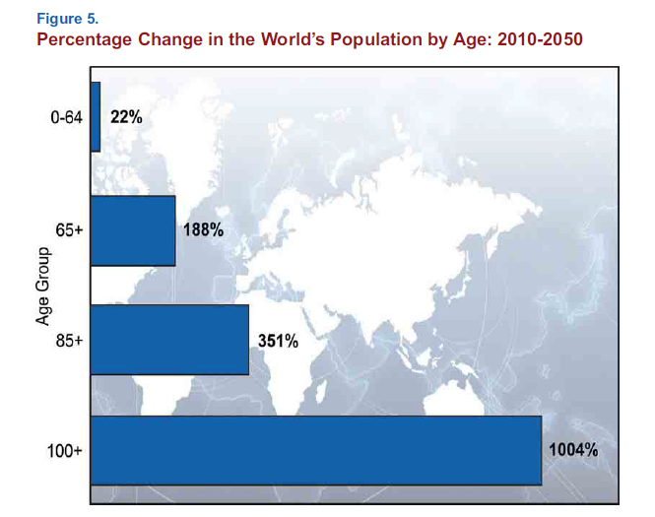

Slide 19
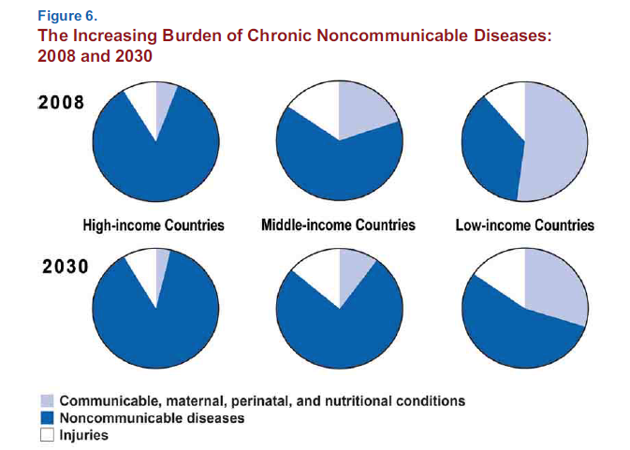

Slide 20
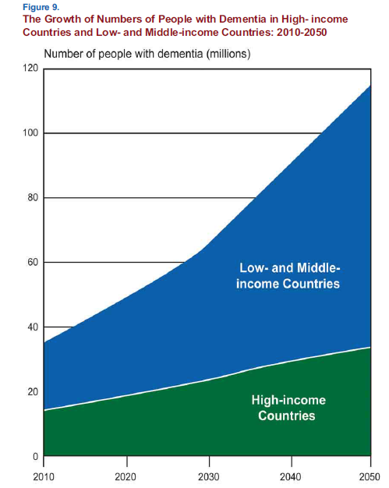

Slide 21
